Slide 1

LEAD SCORE Case Study
SAMIR KHAN

Slide 2
BUSINESS
PROBLEM
An education company named X Education sells online courses to industry professionals. On any given day, many professionals who are interested in the courses land on their website and browse for courses.
X Education has appointed you to help them select the most promising leads, i.e. the leads that are most likely to convert into paying customers. The company requires you to build a model wherein you need to assign a lead score to each of the leads such that the customers with higher lead score have a higher conversion chance and the customers with lower lead score have a lower conversion chance. The CEO, in particular, has given a ballpark of the target lead conversion rate to be around 80%.

Slide 3
Methodology and Approach
Data Cleaning
we noticed some columns having the label as ‘Select’ implying the customer has chosen not to answer the question. Hence, we changed this label with null values.
removed columns having more than 40% null values
Data Transformation
Grouped several columns based on their values to perform better analysis.
Dropped all the Sales generated columns, and treated the outliers.
Data Preparation
Converted the Binary Variables to ‘0’ and ‘1’ and created dummies for categorical variables.
Partitioning of the dataset into train and test.

Slide 4

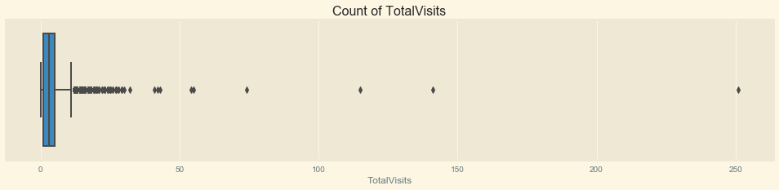
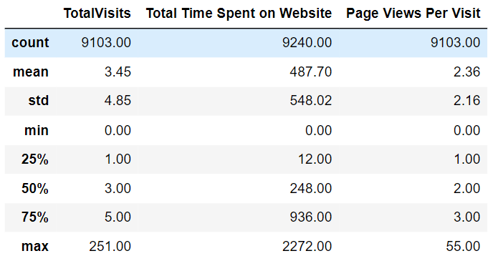
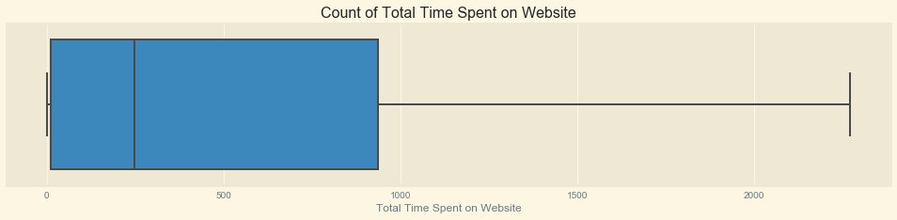
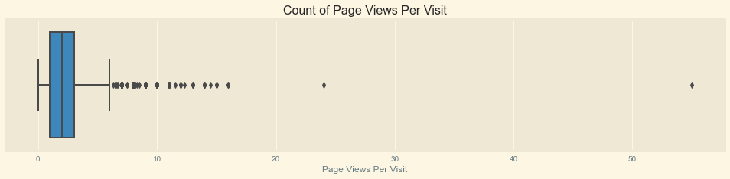
Analysis of Numerical Variables:
The numerical columns consists of TotalVisits, Total time spent on Website, Page Views Per View.
Since there are outliers present we’ll drop the rows having values greater than 99 percentile.
Dropping of outliers is essential for the accuracy of our model .

Slide 5
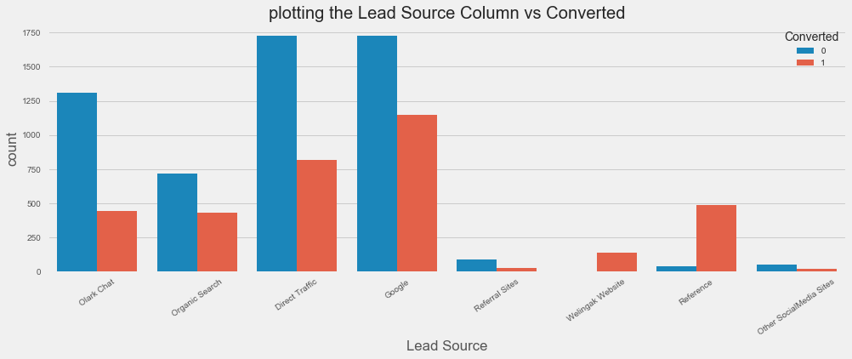
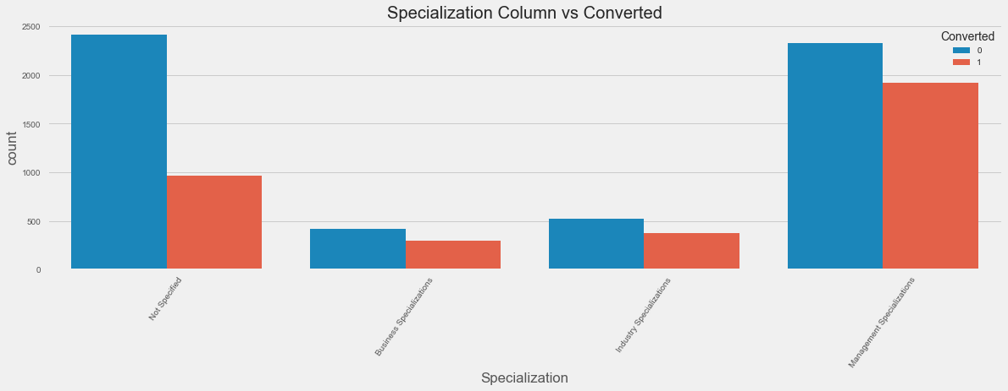
Bivariate Analysis:
Major Inferences:
Google and Direct Traffic has maximum number of leads.
Leads through Reference and Welingak Website have the highest conversion rate.
Other Social Media Sites get the minimum leads.
Maximum leads come from the students who have not specified their specialization.
The number of leads are more from Management Specialization.

Slide 6
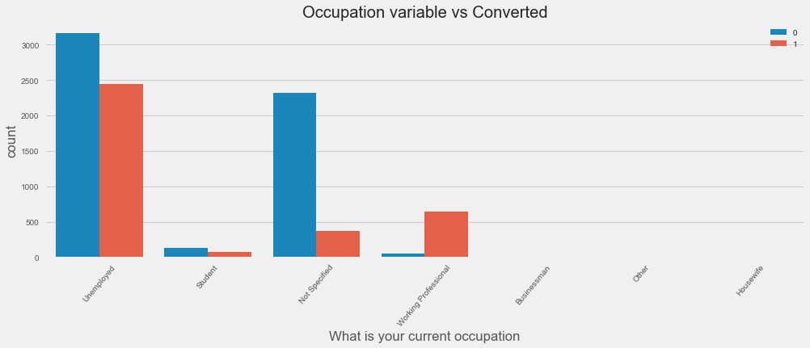
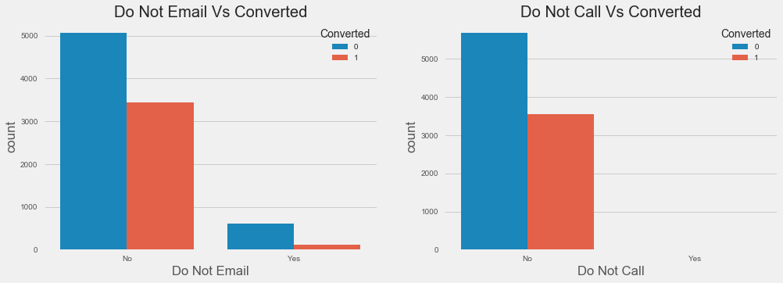
Bivariate Analysis:
Major Inferences:
Unemployed people tend more towards joining the course.
Working Professionals going for the course have a higher chance of joining the course.
Major leads are observed from people who opted for `'Do Not Email'` and `'Do Not Call’`.
Conversion Rate show a similar pattern for both `'Do Not Email'` and `'Do Not Call'` options.

Slide 7

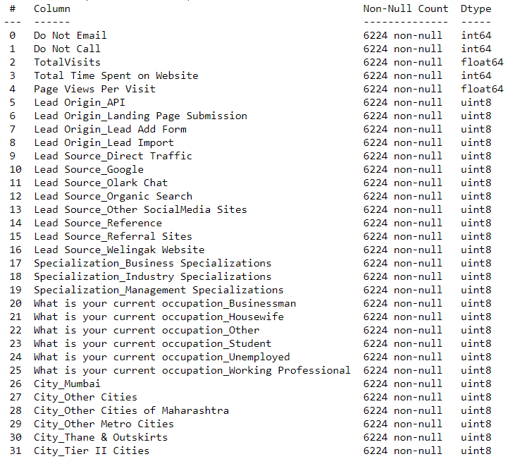
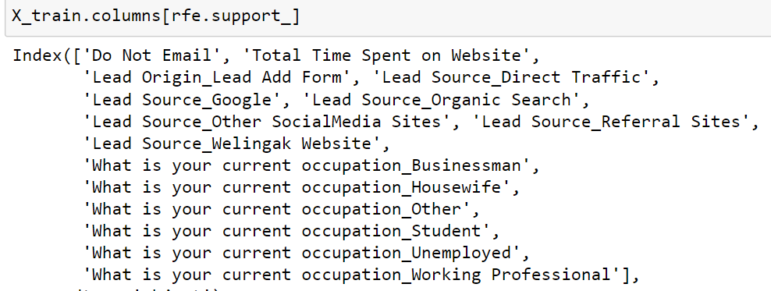
Features before RFE:
After using RFE, we are left-out with 15 Features out of the 32 features initially present

Slide 8

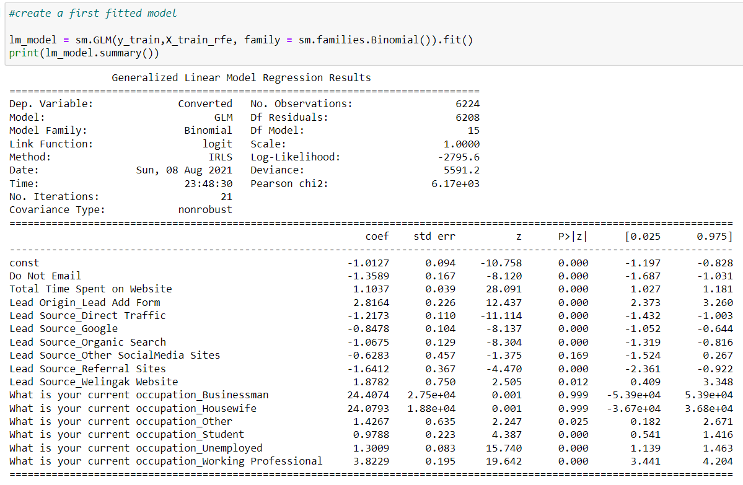
First Logistic Regression Model built
using the RFE supported features:
We’ll drop columns like below, since it has high p-values
Lead Source_Other SocialMedia Sites (16.9%)
What is your current occupation_Businessman(99.9%)
What is your current occupation_Housewife(99.9%)

Slide 9
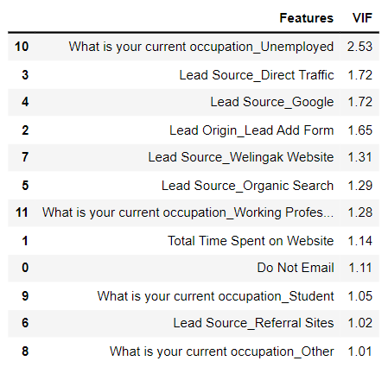
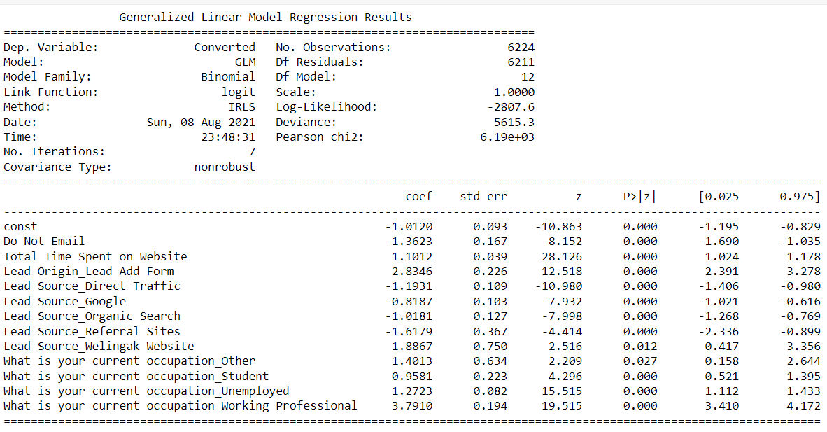
Final Model After dropping multiple features:
VIF values of all features are less than 5, hence no need of further feature elimination
The p-value of all features <5%

Slide 10
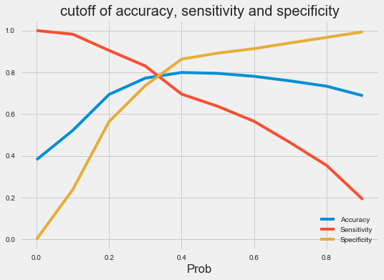

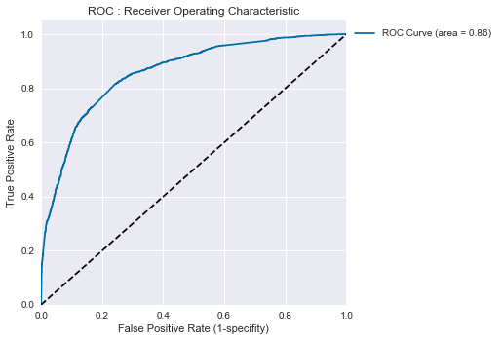

The curve on the left indicates that the threshold probability for Evaluation metrics cut off is 0.3
ROC curve for Train Dataset
The area under the curve = 0.86
The curve is inclined towards the upper left corner indicating the model is performing well.

Slide 11
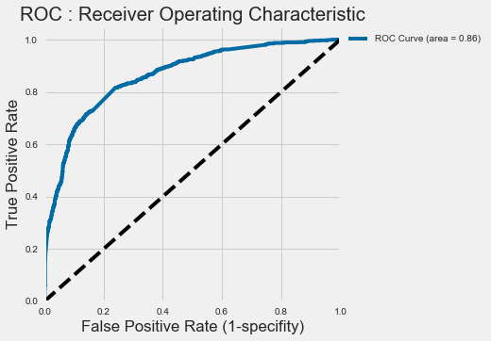
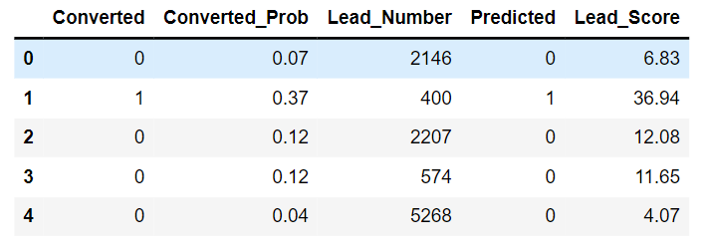
ROC Curve for Test dataset:
The below table describes the Predicted value based on the final model keeping cutoff at 0.3,

Slide 12
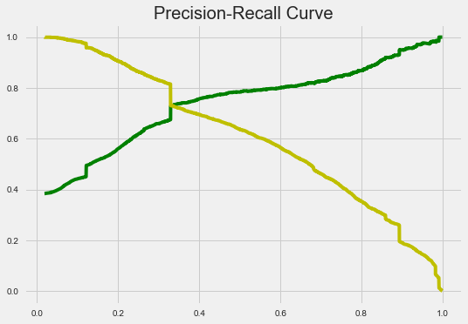
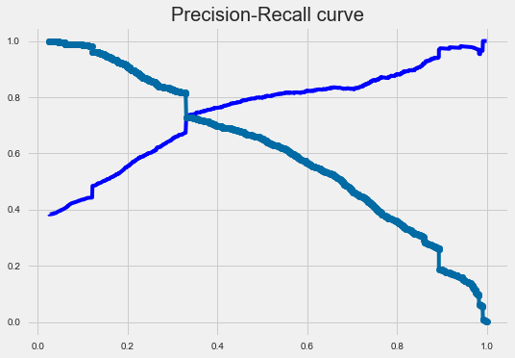
Precision Vs Recall Curve:
Train Dataset
Test Dataset
From the above graphs, we can conclude that both Train and Test dataset have the same cut off for precsion-recall curve

Slide 13
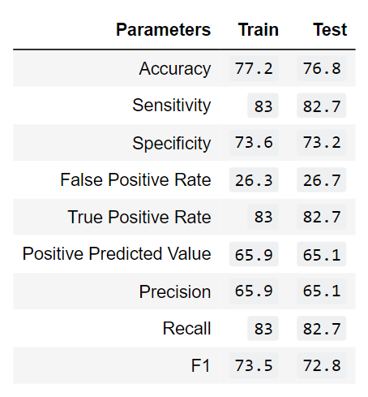
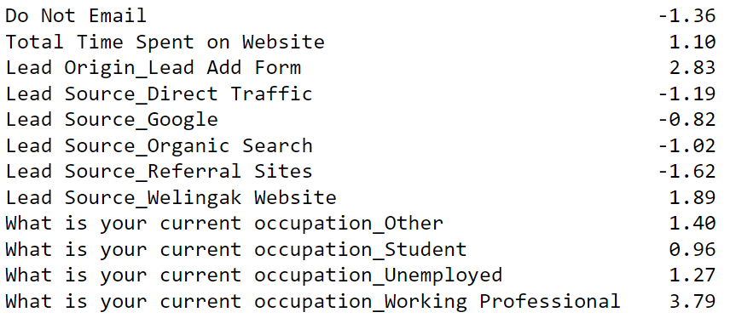
Feature importance:
From above fig, we can see that there are 5 with negative coefficient and 7 features have positive coefficient values.
The above table explains the values of the evaluation metrics for both train and test dataset

Slide 14

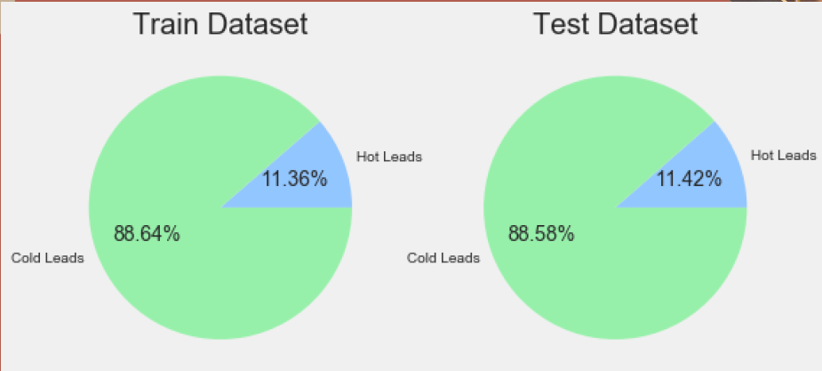

Hot Vs Cold Leads:
The above mentioned pie charts explains the distribution of Hot leads in both train and test datasets
We can clearly see that only 11% of total leads belong to Hot segment

Slide 15
CONCLUSIONS:
- Depending on the business requirement, we can increase or decrease the probability threshold value with in turn will decrease or increase the Sensitivity and Specificity of the model. High Sensitivity will ensure that almost all leads who are likely to Convert are correctly predicted.
-As per the business problem, CEO needed a target lead conversion rate to be around 80%, which is achieved by adjusting the value of sensitivity above 80%. Clearly, this was witnessed from the model built.
-Finally, a lead score was imparted based upon the probabiltybeing predicted from the model which ultimately helped in identifying the Hot Leads.

